Slide 1
Project 1
To improve participation rates of SAT

Slide 2
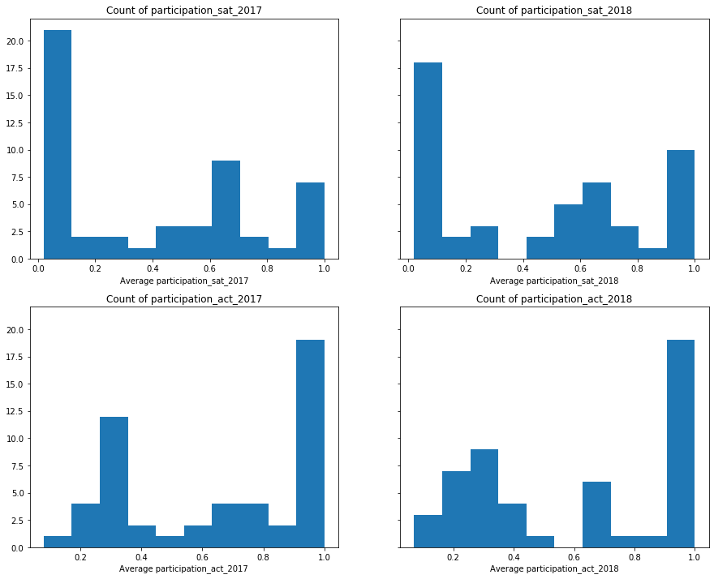
SAT vs ACT 2017 and 2018
The ACT participation rates among states are leading SAT participation rates both in 2017 and 2018
Mean ACT participation rate:
2017: 0.65
2018: 0.62
Mean SAT participation rate:
2017: 0.40
2018: 0.45

Slide 3
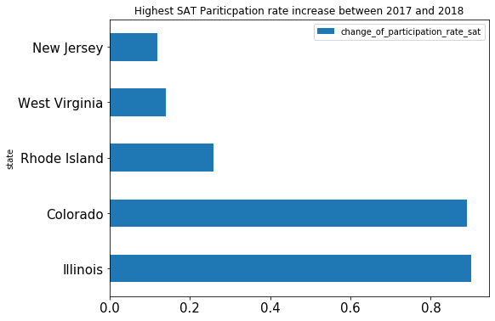
SAT Participation rate increase
The state of Illinois had the highest increase in SAT participation rate of 0.9 or 90%
The state of Colorado trails behind an increase of 0.89 or 89%.

Slide 4
What did they do?
Making SAT mandatory
Subsidies the cost of SAT test
SAT to be held on school day

Slide 5
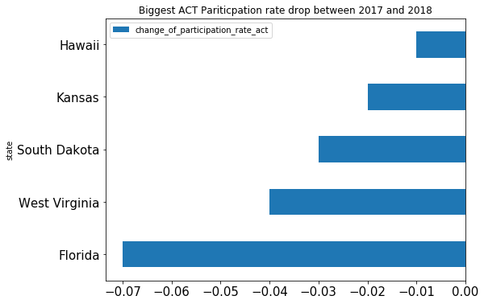
ACT Participation rate change
The state of Florida had the biggest drop in ACT participation rate of 0.07 or 7%
Florida’s ACT participation rate 2018 is 66%
Florida’s SAT participation rate 2018 is 56%

Slide 6
Which state should we choose?
The state of Florida had the biggest drop in ACT participation rate of 0.07 or 7%
Florida did not mandate students to take SAT or ACT
Florida’s high school graduates population
2017: 177,707
2018: 181,306
For comparison, 2018 have close to 2 million people taking SAT
Florida is 1 of the states with the most number of high school graduates. A small increase in participation rate would mean larger increase in number of SAT takers as compared to smaller states.

